Slide 1
Java 4 WEB
Lesson 5 – Home tasks overview

Slide 2
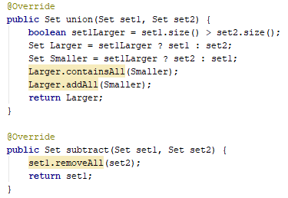
1. Avoid modification of input arguments
Notes:
Method should modify only this object but not input data

Slide 3
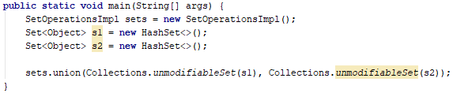

1. Avoid modification of input arguments
Notes:
Method should modify only current object but not input data

Slide 4
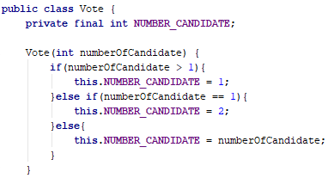
2. Do not write useless code
Notes:
If blocks do nothing useful

Slide 5
3. Follow convention
Notes:
Follow naming convention

Slide 6
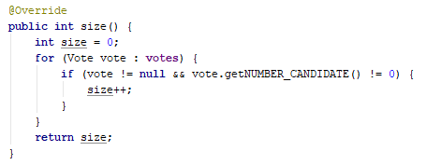
4. Keep it simple
Notes:
Why candidate 0 processed specifically?

Slide 7
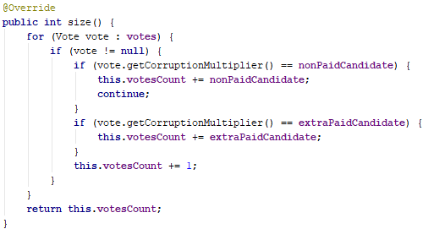
4. Keep it simple 2
Notes:
Candidate type should be used only during insertion

Slide 8
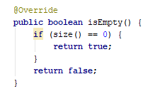

4. Keep it simple 3
Notes:
No sense in if-else and return boolean, inline result can be calculated

Slide 9
5. Performance
Performance test should measure same action many times and calculate average but not single run. Performance tests works incorrectly

Slide 10
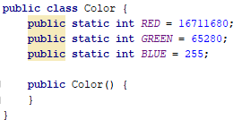
6. Understand the task
Notes:
Color should have 3 properties RGB. How are you going to extend and add new colors?

Slide 11
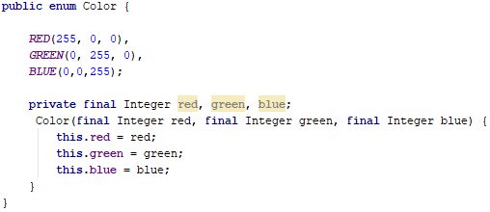
7. Think about extension
Notes:
How new color should be added? Enum with 16M value is not good idea

Slide 12
8. Better commit messages
L01 gradle fix
L02-T3 fix SystemInfoProvider.GetJavaVersion
L04-T2 in User class delete isEqualPassword method, exceptions now inherited from AuthException
L05-T2 Implemented SetOperationsImpl class
IU-2018.2.4 <admin@DESKTOP-GJ39N5M Merge branch 'master‘
L01 -T1 Implemented Car Factory
L04-T1 "fix +/- value“
L05-T3 "from list to array“
L05-T4 "removal of excess“
L04-T2 Made abstract

